Slide 1

Opinion Mining for Comment Sentiment Analysis
Guide
Presented By
Dr. Shashi Kr Singh
Prof. CSE Dept.
Rahul Gupta (21EMCAD045)
Sourabh Meena (21EMCAD054)
Narayan Somvanshi (21EMCAD037)

Slide 2
ABSTRACT
Opinion mining, also known as sentiment analysis, is a process used to classify user-generated content such as reviews, comments, and social media posts into categories such as positive, negative, or neutral. Our project involves processing comments in multiple languages and analyzing sentiments automatically using machine learning and natural language processing (NLP) techniques. This solution helps businesses or individuals understand user opinions and enhance decision-making based on public feedback.

Slide 3
PROBLEM STATEMENT
This project addresses the problem of efficiently analyzing and visualizing the sentiment of user-provided comments. Users can input comments or upload a file with multiple comments. The application detects the language, translates comments to English if needed, and performs sentiment analysis to classify them as positive, neutral, or negative. Results are displayed in an easily interpretable format, such as a bar chart or a list, helping users quickly understand the overall sentiment.

Slide 4
TECHNOLOGY STACK
Front-end:
HTML, CSS, JavaScript
Back-end:
Python, Django
Machine Learning:
Scikit-learn, NLTK
Database: SQLite
Libraries for NLP:
NLTK, TextBlob

Slide 5
EXISTING SYSTEM
Single-Language Focus: Tools like TextBlob and VADER handle sentiment analysis but mainly for English texts, struggling with multilingual support. They often fail to accurately analyze sentiments in non-English comments.
Limited Context Awareness: Current systems often misinterpret sarcasm or context-specific sentiments. They lack the ability to understand the deeper meaning behind words, leading to incorrect sentiment classification.
Batch Processing, Not Real-Time: Most systems process comments in batches and lack real-time capabilities for bulk data. This means they cannot provide immediate feedback or analysis for streaming data.

Slide 6
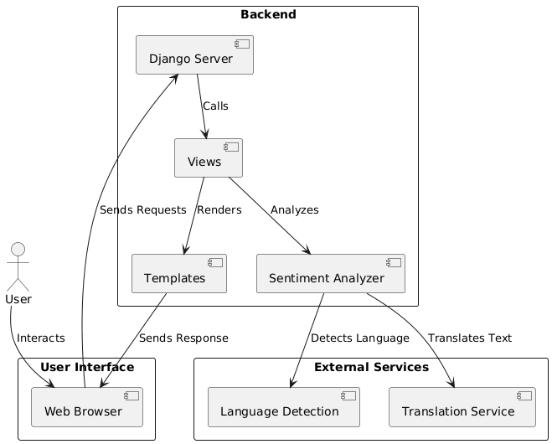
PROPOSED DIAGRAM

Slide 7
CURRENT STATUS
1. Completed
Basic Sentiment Analysis
Multilingual Support
Sentiment Visualization
2. In Progress
Real-Time Sentiment Analysis
Enhanced Context Awareness
3. Next Steps
Integration with Social Media APIs
Advanced Sentiment Categories
User Interface Improvements

Slide 8
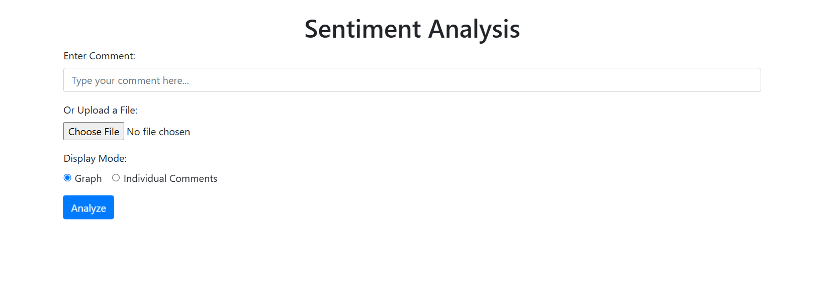

Slide 9
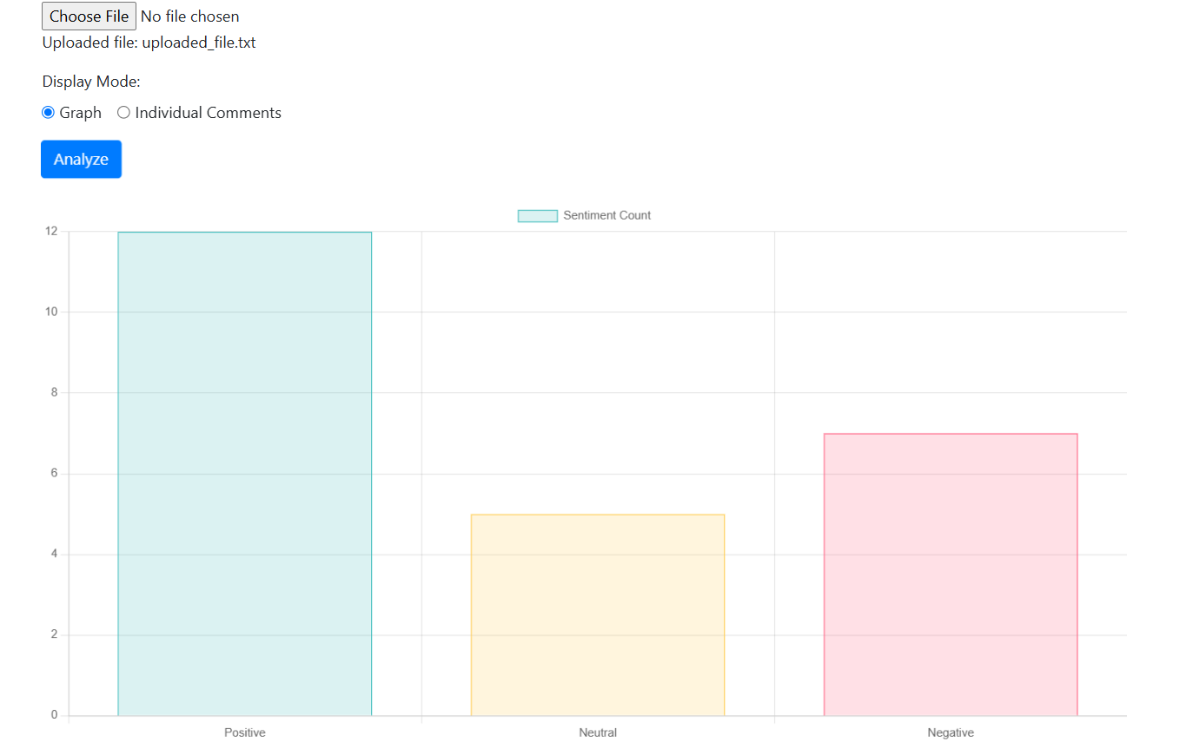

Slide 10
REFERENCES
Bo Pang and Lillian Lee, 'Opinion Mining and Sentiment Analysis,' Foundations and Trends in Information Retrieval, Vol. 2, No. 1-2, pp. 1-135, 2008.
B. Liu, 'Sentiment Analysis and Opinion Mining,' Morgan & Claypool Publishers, 2012.
A. Kharde and S. Sonawane, 'Sentiment Analysis of Twitter Data: A Survey of Techniques,' International Journal of Computer Applications, Vol. 139, No. 11, 2016.

Slide 11


